Slide 1
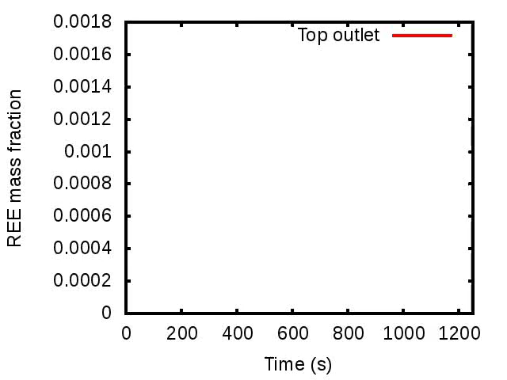
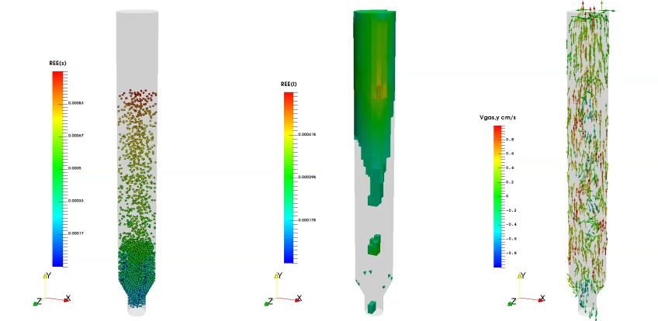
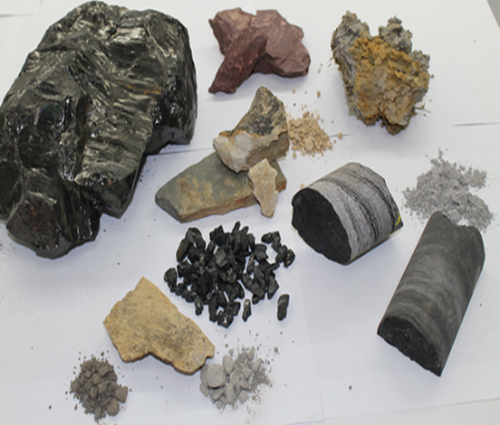
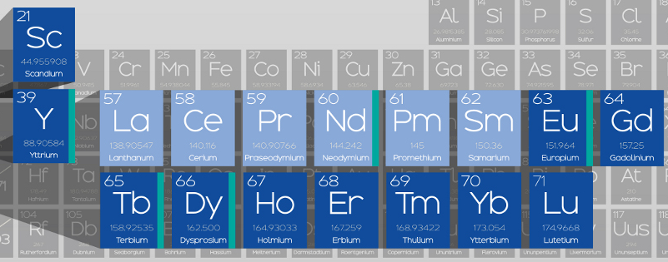
Coarse grained particle method for simulation of liquid-solids reacting flow
MFIX-DEM
MFIX-CGP
Rare Earth Elements leaching from coal-byproducts
Vitamins
of modern industry
Waste
Liqiang Lu (NETL ORISE)
Kisoo Yoo (NETL ORISE)
Sofiane Benyahia (NETL)

Slide 2
Outlines
1. Physical model of coarse grained particle method (CGPM)
2. Computation speed of CGPM Vs. MP-PIC
3. Simulation of a bubbling fluidized bed
4. Simulation of a counter-current fluidized leaching bed
5. Summary

Slide 3
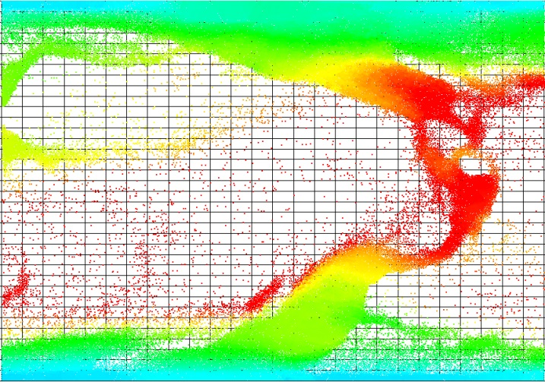
Physical model of CGPM: general introduction
To capture particle-scale chemical reactions
Euler-Lagrangian method
Collision force is NOT calculated
MP-PIC ( W=8 )
Non-physically overlapped, pass through
16
particles
CGPM (W=8)
Coarse grained
particle method
Computationally
infeasible for real systems!
Solved by lumping several real particles into a parcel
Collision force is calculated!
Solid flow = 18.4kg/h
Residence Time=80s
Simulate 400 s, using 100 cores with 100% efficiency.
Time needed ~ 3.65 YEARs!
Particle number
Time steps
Small time steps
Huge number of particles
Improved Speed
Guaranteed Accuracy
Kazari, M., Roko, K., Kawaguchi, T., Tanaka, T.a.T., Y.,, 1995. A Study on Conditions for Similarity of Particle Motion in Numerical Simulation of Dense Gas-Solid Two Phase Flow.
Benyahia, S., Galvin, J.E., 2010. Estimation of Numerical Errors Related to Some Basic Assumptions in Discrete Particle Methods. Industrial & Engineering Chemistry Research 49, 10588-10605.
Lu, L., Xu, J., Ge, W., Yue, Y., Liu, X., Li, J., 2014. EMMS-based discrete particle method (EMMS–DPM) for simulation of gas–solid flows. Chemical Engineering Science 120, 67-87.
Not NEW, Need verification in Liquid-Solids Reacting flow
Particle Number = 6.4 x10⁶
Time steps = 1.0x10⁻⁶S

Slide 4
Physical model of CGPM: our implementation of CGPM in MFIX
Same F_{drag}
Same k_{chem}
DEM
CGPM
/W
The drag force is same for each real particle within a CGP
Well accepted
The species concentration is same for each real particle within a CGP
The chemical reaction is same for each real particle within a CGP
Newly added
The collision force is calculated by DEM using a collision diameter of d_{CGP} = d_{p}W^{1/3}
The spring constant is same to that used in traditional CFD-DEM simulation
The restitution coefficient is smaller to keep a same energy dissipation^{[1,2]} (in gas-solids flow)
or taking into the effect of hydrodynamic lubrication^{[3]} (in liquid-solids flow)
Other properties (like friction) are same to original particles
Little physical basis, strong assumptions,
Need further investigation
[1] Benyahia, S., Galvin, J.E., 2010. Estimation of Numerical Errors Related to Some Basic Assumptions in Discrete Particle Methods. Industrial & Engineering Chemistry Research 49, 10588-10605.
[2] Lu, L., Xu, J., Ge, W., Yue, Y., Liu, X., Li, J., 2014. EMMS-based discrete particle method (EMMS–DPM) for simulation of gas–solid flows. Chemical Engineering Science 120, 67-87.
[3] G. G. JOSEPH, R. ZENIT, M. L. HUNT and A. M. ROSENWINKEL (2001). Particle–wall collisions in a viscous fluid. Journal of Fluid Mechanics, 433, pp 329-346

Slide 5
Physical model of CGPM: Governing equations, implemented in MFIX, with hybrid parallel
Fluid phase equations
Solid phase equations
Fluid phase continuity:
Fluid phase momentum:
Interphase momentum transport:
Species transport:
Constitute equations:
The only parameter in this model is: statistic weight W
Accuracy
W
Speed
Compromise between accuracy and speed
Different system has different maximum W
With more accurate interpolation method, Larger W can be used
1 100 200 ……
?
DEM

Slide 6
Outlines
1. Physical model of coarse grained particle method (CGPM)
2. Computation speed of CGPM Vs. MP-PIC
3. Simulation of a bubbling fluidized bed
4. Simulation of a counter-current fluidized leaching bed
5. Summary

Slide 7
Computation speed of CGPM VS MP-PIC
 | MP-PIC | CGPM
dt.CFD | Varied, stabilized at 1.0 x 10⁻³ | Varied, stabilized at 1.0 x 10⁻³
dt.Solid | Varied, stabilized at 1.0 x 10⁻³ | Fixed at 1.0 x 10⁻⁴

Slide 8
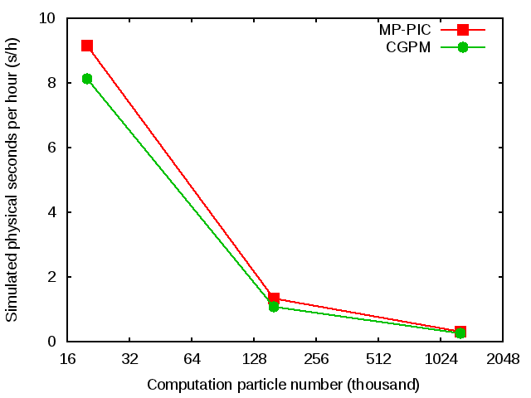
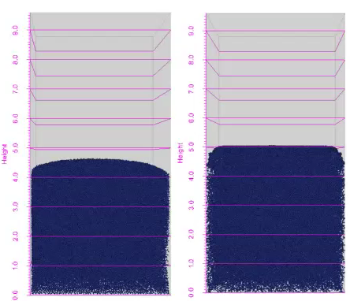
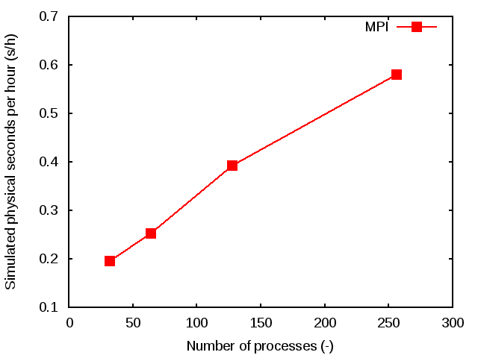
Computation speed of CGPM Vs. MP-PIC
Using 16 CPU cores on a single host with openMP multi-threads
MP-PIC is only about 10%-20% faster than CGPM
The speed priority of MP-PIC is not that much as supposed although time step is 10 times larger.
For 10.24 million computation particles is about 0.58 physical seconds per hour
The corresponding total strong scale efficiency of 256 processes is about 40%
This offers us an opportunity to investigate pilot or even industrial reactors with particle scale models
For simple flow, they gave very similar results.

Slide 9
Outlines
1. Physical model of coarse grained particle method (CGPM)
2. Computation speed of CGPM Vs. MP-PIC
3. Simulation of a bubbling fluidized bed
4. Simulation of a counter-current fluidized leaching bed
5. Summary

Slide 10
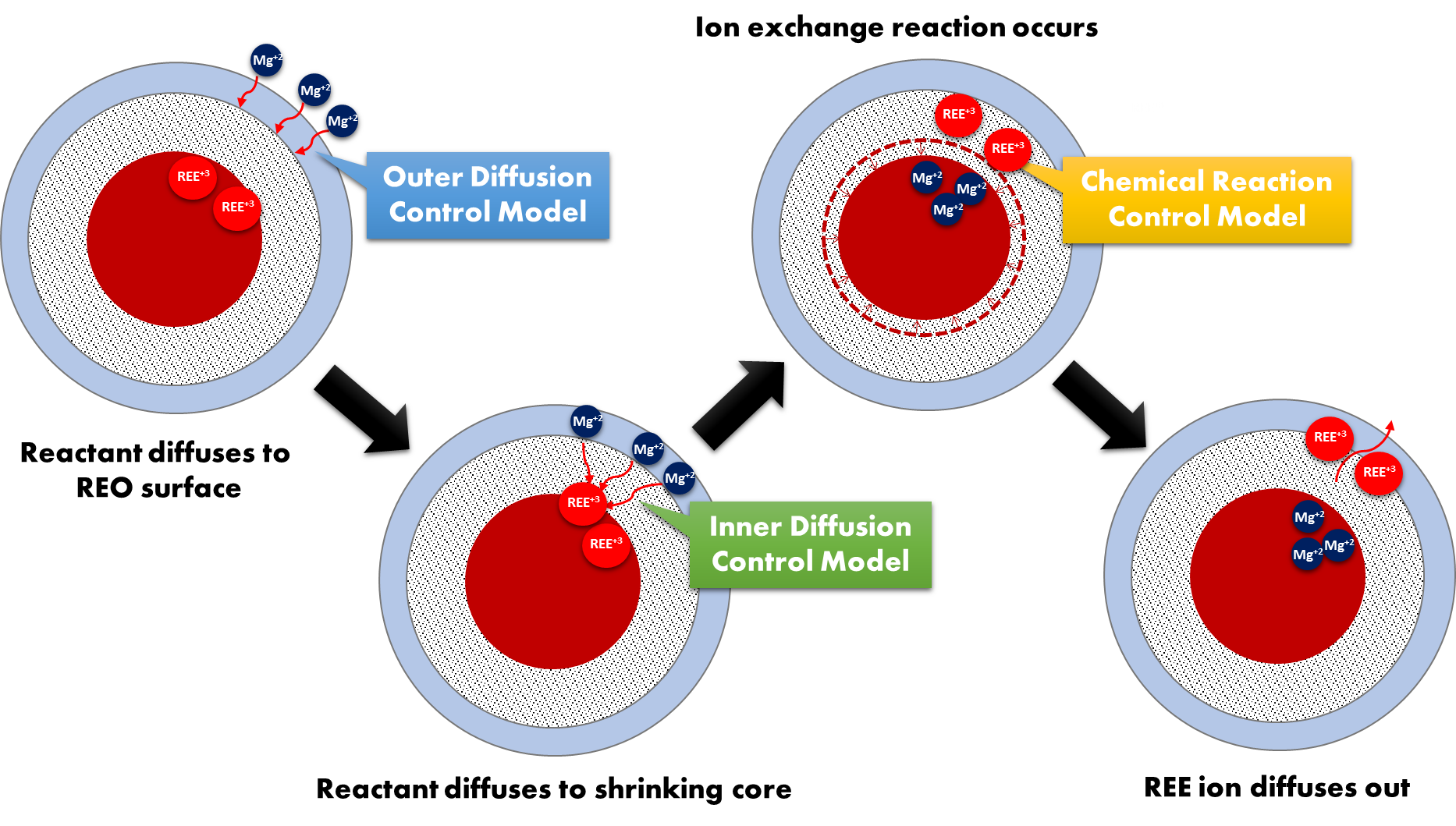
Bubbling fluidized bed: chemical reaction rate
Yoo, K.; Lu, L.; Benyahia, S., Modeling and simulation of rare earth element extraction by ion exchange reaction in batch reactor. submitted to Journal of Hydrometeorology.

Slide 11
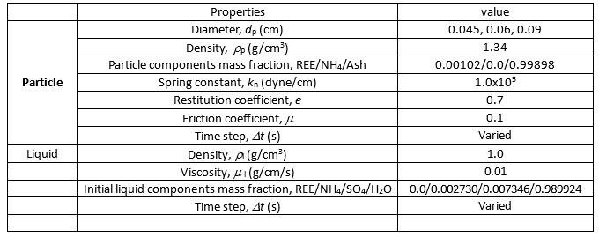
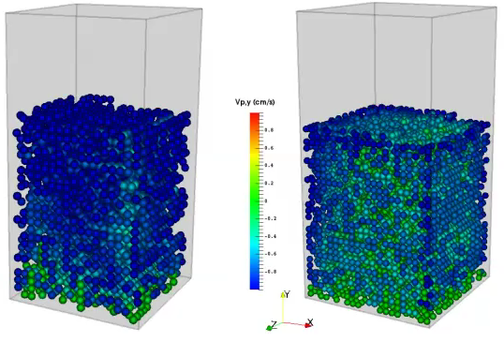
Bubbling fluidized bed: : physical properties and hydrodynamic results
Experiment:
d_{p1} = 0.045~0.060 cm
d_{p2} = 0.060~0.900 cm
d_{p} = 0.045cm, with W=1000(left) and W=500(right)

Slide 12
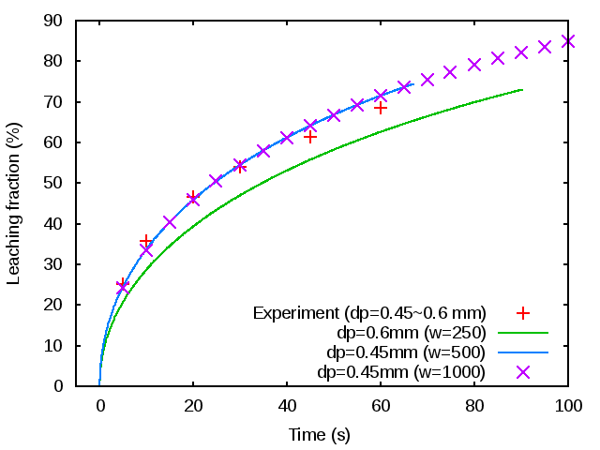
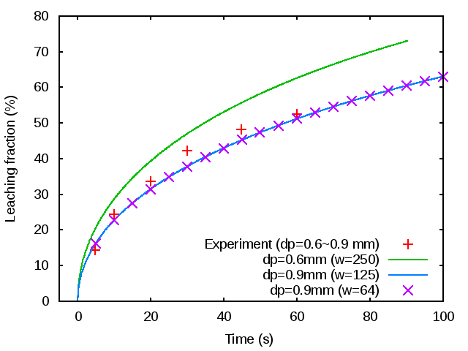
Bubbling fluidized bed: similar chemical reaction results
The simulation result compares well with experimental data
The result is insensitive to statistic weight
The system can be treated as monodisperse and corresponding diameter is 0.45 mm and 0.9 mm.
Xiao, Y.-f., Chen, Y.-y., Feng, Z.-y., Huang, X.-w., Huang, L., Long, Z.-q., Cui, D.-l., 2015. Leaching characteristics of ion-adsorption type rare earths ore with magnesium sulfate. Transactions of Nonferrous Metals Society of China 25, 3784-3790

Slide 13
Outlines
1. Physical model of coarse grained particle method (CGPM)
2. Computation speed of CGPM Vs. MP-PIC
3. Simulation of a bubbling fluidized bed
4. Simulation of a counter-current fluidized leaching bed
5. Summary

Slide 14
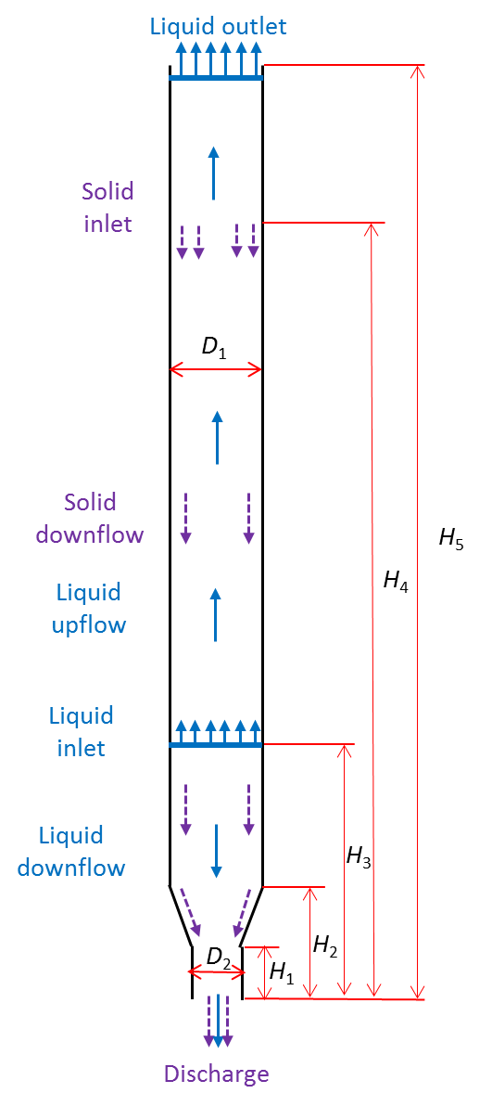
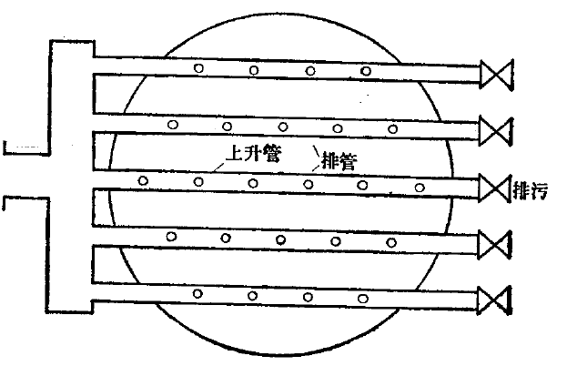
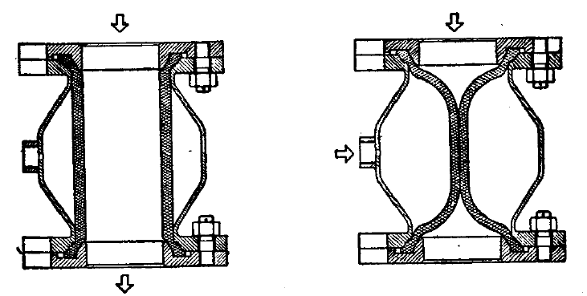
Counter-current fluidized bed: geometry and operating conditions
Varied operating condition & reactor geometry
Simulated with point source
Leachate recycling
Residence time & inlet position
Valve open
Valve closed
Decreasing the L:S ratio
Simulated with pressure drop in porous medium
Increasing REE
concentrations

Slide 15
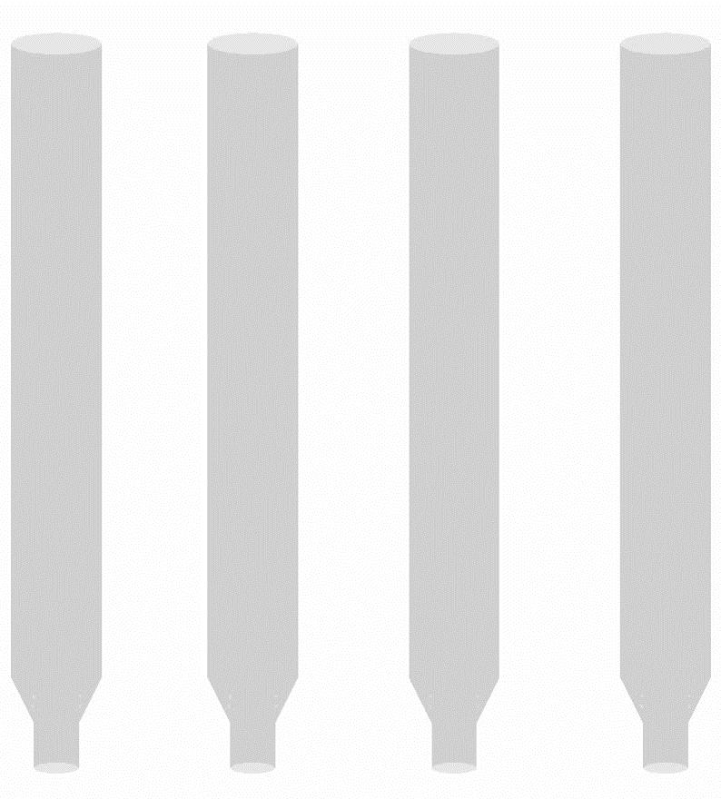
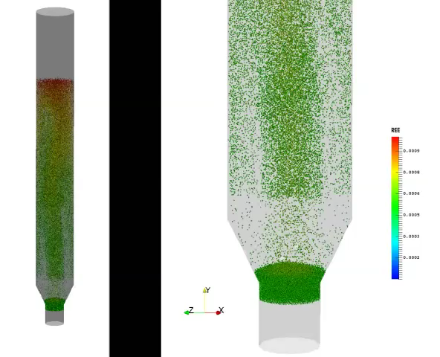
Counter-current fluidized bed case Base: Solid movement
Solid inlet
Liquid inlet
Base
SIH58
L36
L36S36
W20

Slide 16
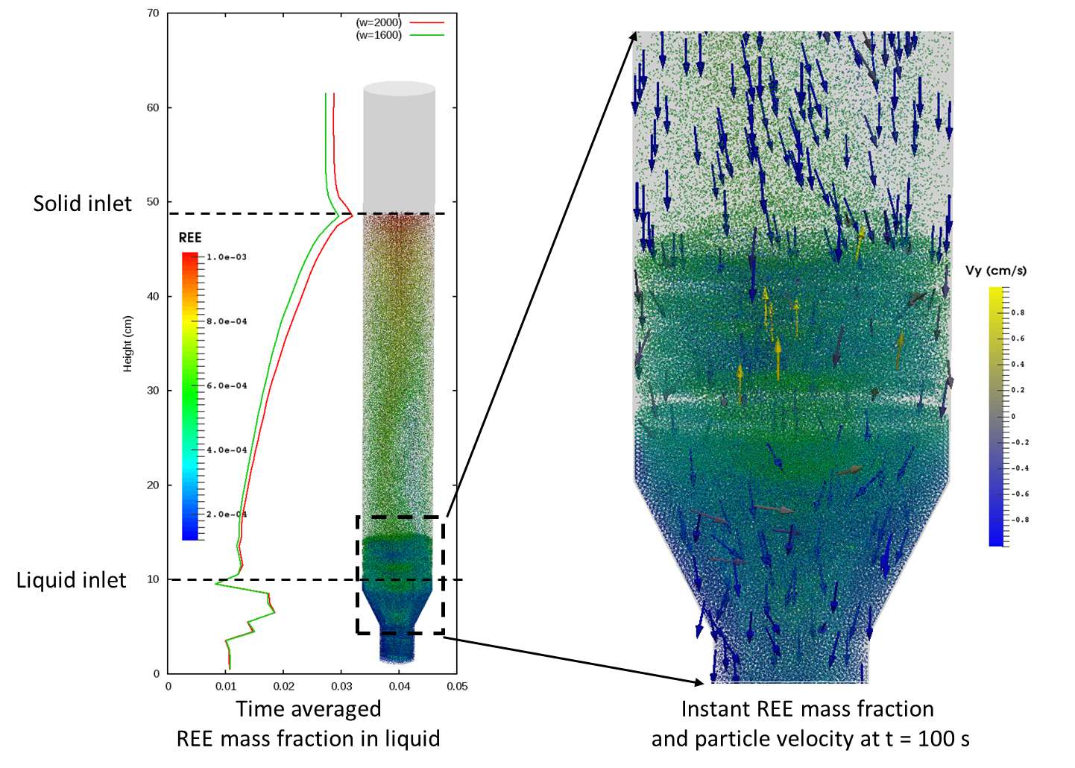
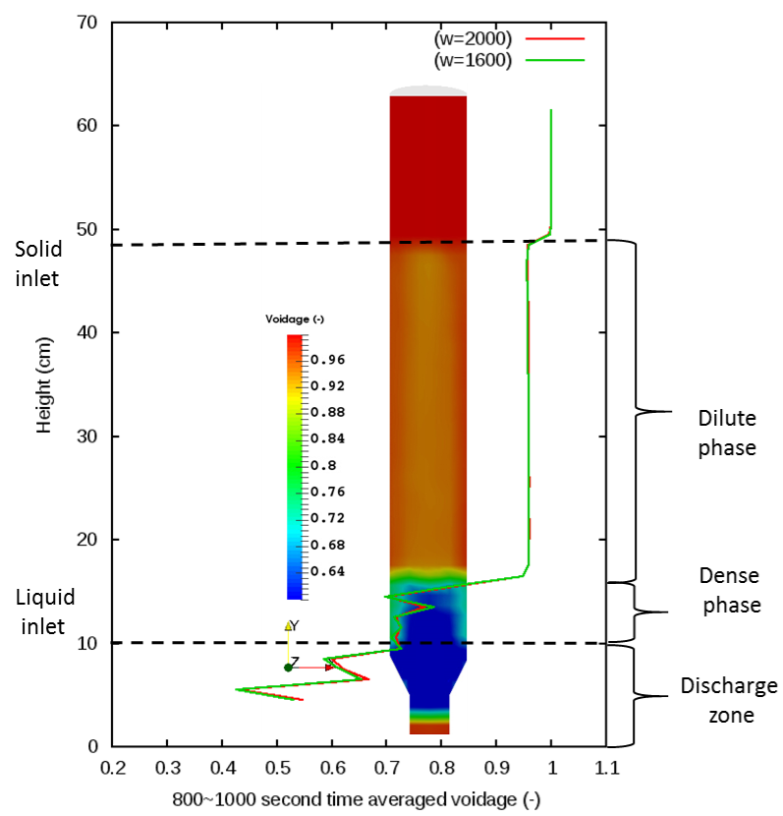
Counter-current fluidized bed case Base : solid distribution
There is a dense phase near the liquid inlet and above the dense phase is the dilute phase
The REE mass fraction gradient is well established in both dilute region and dense region

Slide 17
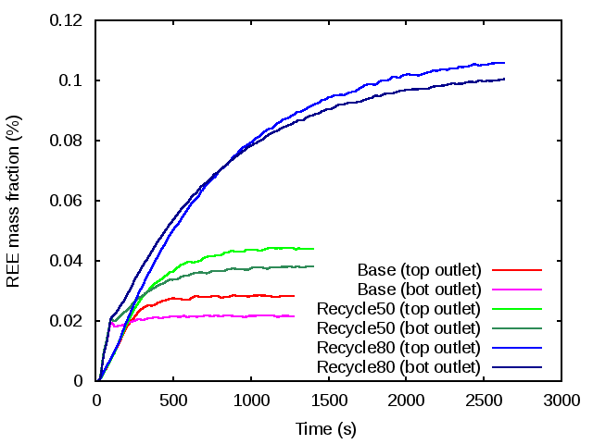
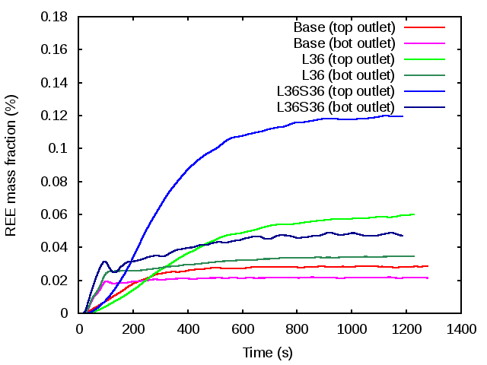
Counter-current fluidized bed : Reactant recycle & L:S ratio
REE mass fraction at top outlet and bottom outlet with different liquid recycle fraction
REE mass fraction with reduced liquid-solids ratio
Lu, L., Yoo, K., Benyahia, S., 2016. Coarse grained particle method for simulation of liquid-solids reacting flows. Submitted to I&ECR

Slide 18
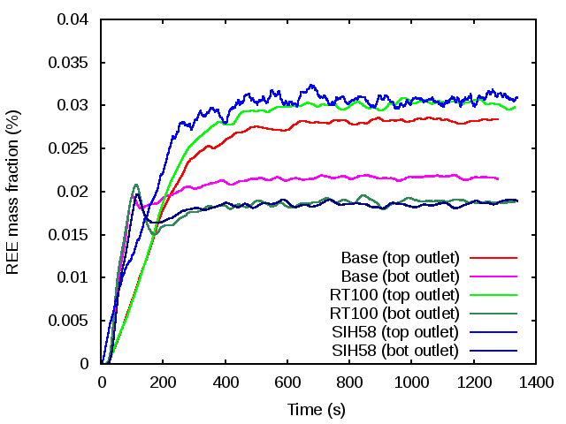
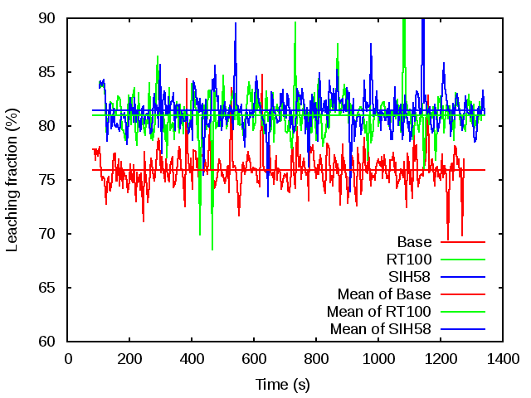
Counter-current fluidized bed : residence time & inlet position
REE mass fraction with increased residence time and elevated solids inlet position
REE leaching fraction variation with increased residence time and solid inlet position
Lu, L., Yoo, K., Benyahia, S., 2016. Coarse grained particle method for simulation of liquid-solids reacting flows. Submitted to I&ECR

Slide 19
Outlines
1. Physical model of coarse grained particle method (CGPM)
2. Computation speed of CGPM Vs. MP-PIC
3. Simulation of a bubbling fluidized bed
4. Simulation of a counter-current fluidized leaching bed
5. Summary

Slide 20
Summary
Potential to Include CFD in Process Simulator
Varied Process Conditions
MFIX-CGPM
Thousands of Seconds Simulation
Optimize
Chemical Reactors

Slide 21
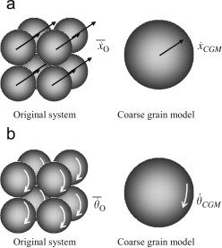
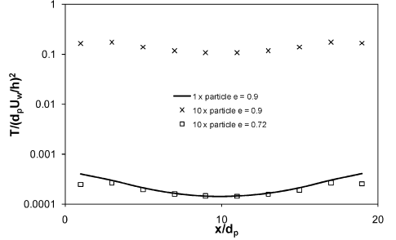

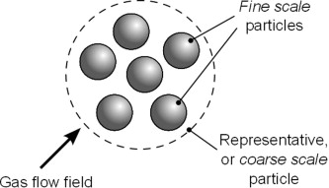
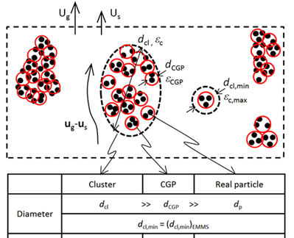
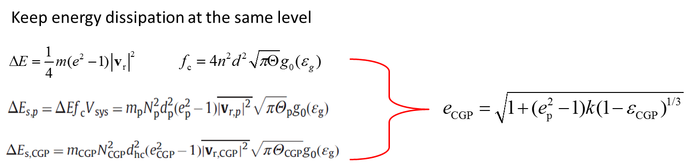
A1. Physical model of CGPM: recent researches in this area
1 | Sakai, M.; Koshizuka, S., Large-scale discrete element modeling in pneumatic conveying. Chem. Eng. Sci. 2009, 64, (3), 533-539. | Binary collision due to all the original particles included in the coarse grain particle occurs when the binary collision of the coarse particle i and j is occurred.
2 | Benyahia, S.; Galvin, J. E., Estimation of Numerical Errors Related to Some Basic Assumptions in Discrete Particle Methods. Ind. Eng. Chem. Res. 2010, 49, (21), 10588-10605. | To account for the extra dissipation due to the increased number of collisions, a modification to the restitution coefficient is proposed.
3 | Hilton, J. E.; Cleary, P. W., Comparison of non-cohesive resolved and coarse grain DEM models for gas flow through particle beds. Appl. Math. Model. 2014, 38, (17–18), 4197-4214. | The directions of the normal forces for all the fine grain particle contacts are parallel and aligned There are no strong pressure gradients within a coarse grain particle. Gas velocity is constant across the coarse grain particle.
4 | Lu, L.; Xu, J.; Ge, W.; Yue, Y.; Liu, X.; Li, J., EMMS-based discrete particle method (EMMS–DPM) for simulation of gas–solid flows. Chem. Eng. Sci. 2014, 120, (0), 67-87.

Slide 22
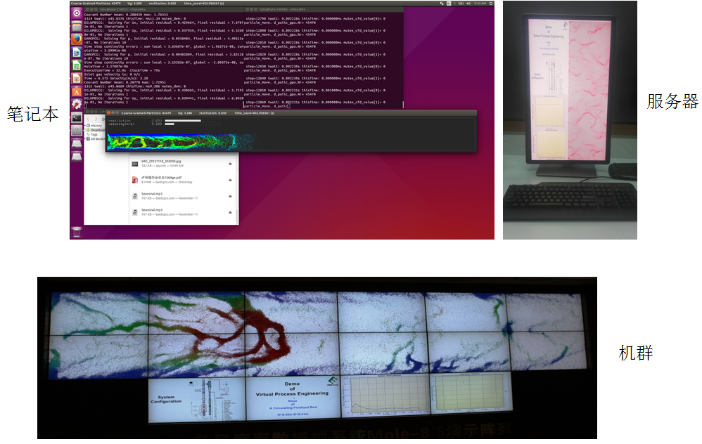
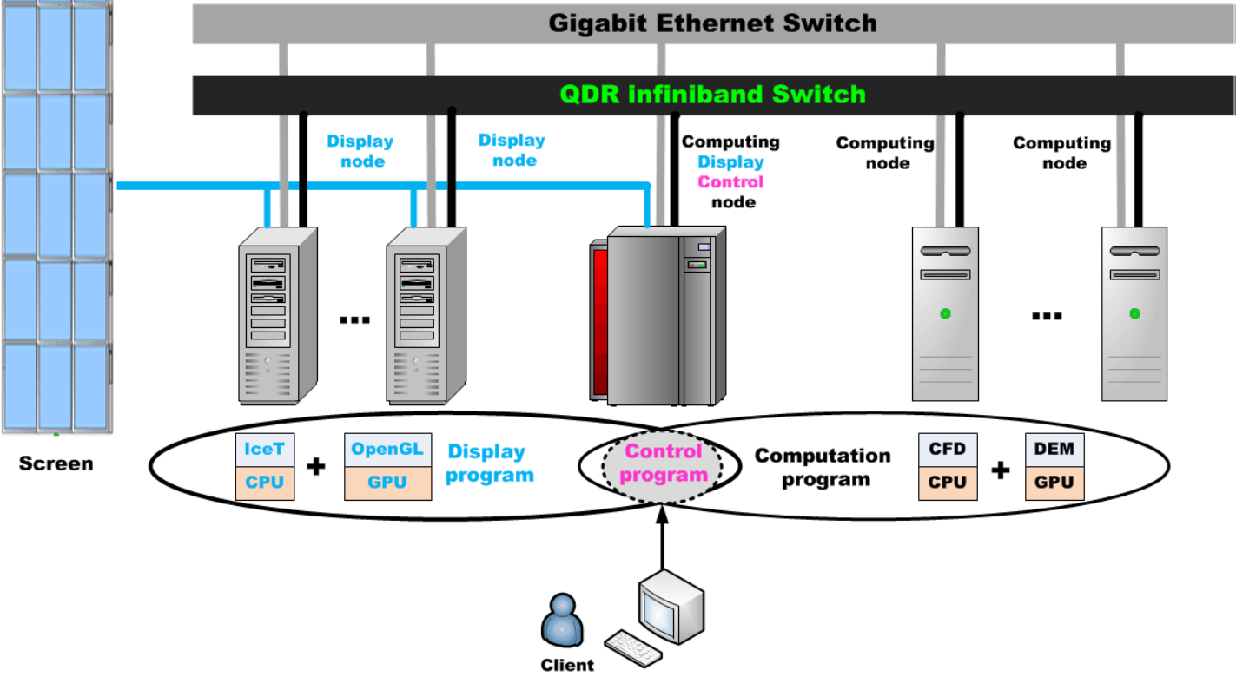
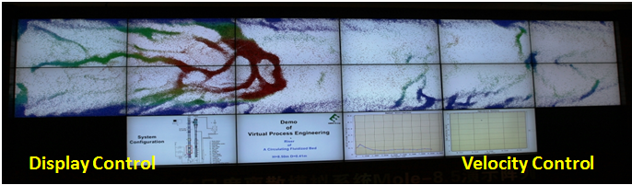
A2: GPU Accelerated on-line interactive simulation (work from other group)
On a personal laptop (45k parcels @ 1 GPU)
On a GPU cluster (200k parcels @ 12 GPUs)
Ge, W. et al. 2015. Multiscale discrete supercomputing - a game changer for process simulation? Chemical Engineering & Technology 38, 575-584.
Lu, L. et al. 2016. Computer virtual experiment on fluidized beds using a coarse-grained discrete particle method. Chemical Engineering Science (http://www.sciencedirect.com/science/article/pii/S0009250916304353)

Slide 23
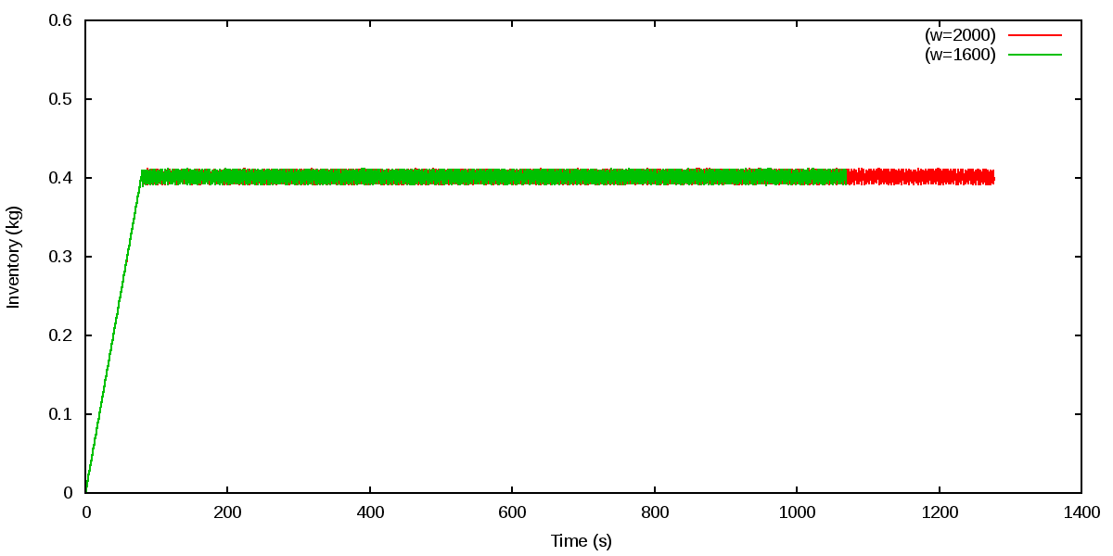
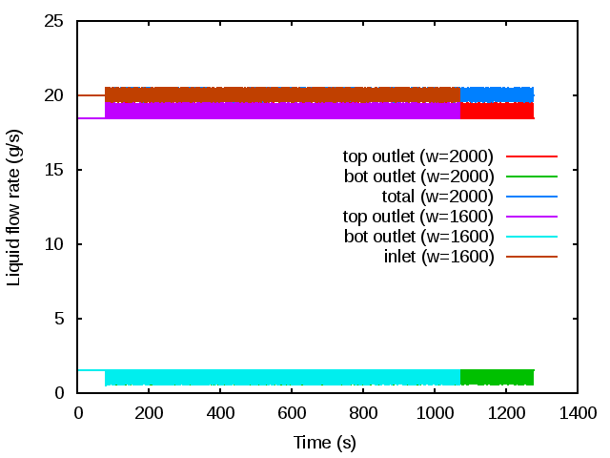
A3: Counter-current fluidized bed case Base: stable operation
The particles are added into the reactor from time 0 s and reach a stable state after about 80 s.
total = top outlet + bot outlet
Inlet = 20 g/s
At the beginning, the flow rate at both top outlet and bottom outlet are constant and summed up equals the inlet rate 20 g/s.
After around 80 s, a little fluctuation is also observed due to the outflow of particles.

Slide 24
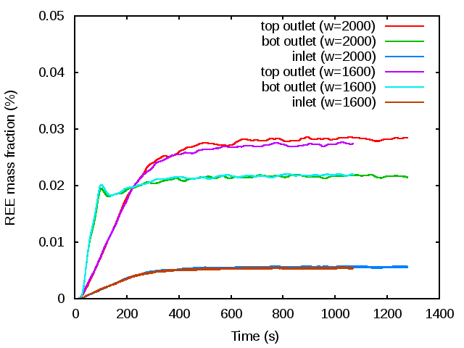
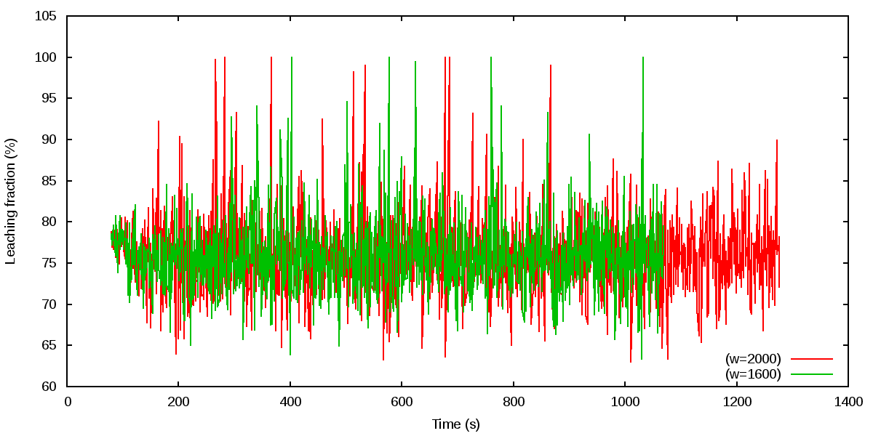
A4: Counter-current fluidized bed case Base: product quality
In the simulation, 20% of the total outlet liquid is mixed with original liquid and recycled into the reactor.
There is a great change at first 200 s and at about 800 s the REE mass fraction at outlet reaches 0.028% and stabilized.
Because of recycled liquid, the REE leaching fraction at outlet is reduced from 80% to 75% at first 200 s and then stabilized

Slide 25
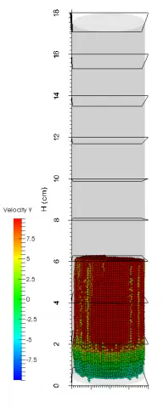
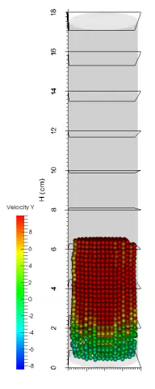
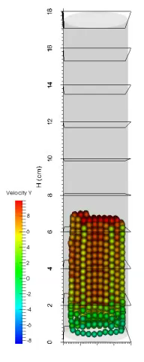
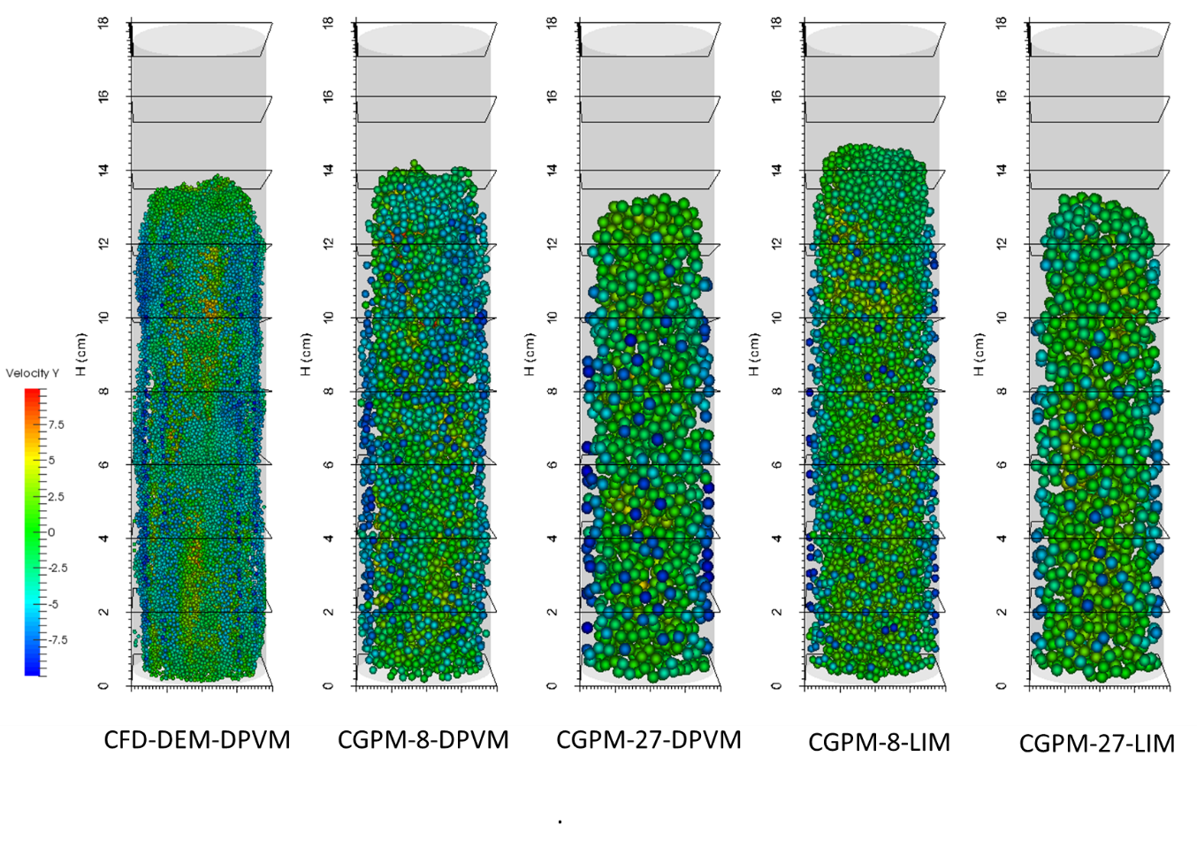
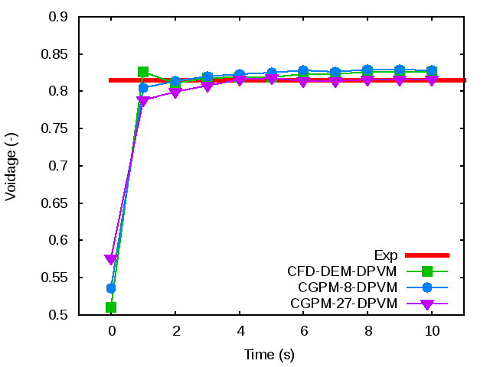
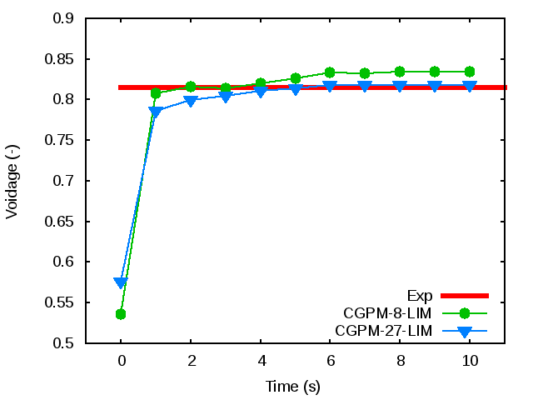
A5: Verification of CGPM: improved result with more precise interpolation schemes
W = 1, 8, 27 with DPVM
Increase the influence area of coarse grained particles!

